Slide 1
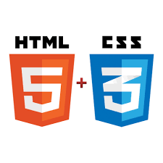



















Front : HTML5/CSS3/JavaScript frameworks
Back : Java/Caching/Data access technologies
Spring Boot
Spring Data JPA
Spring Security
Spring MVC REST
Spring Test Context
design time
integration time
production time

